Slide 1
Spammer Detection And Fake User Identification On Social Networks
Presented by
Batch – A13
B.DEVANANDINI(Y19ACS420)
K.SUMA(Y19ACS482)
L.AJAY KUMAR(Y19ACS496)
A.HARSHA VARDHAN(Y19ACS411)
Under the guidance of
V. NAVEEN KUMAR
Asst.Professor

Slide 2
Contents
Abstract
Existing System
Literature Survey
Software And Hardware Requirements
Proposed system
Module Design And Functionality
Libraries
Algorithms/ Coding Details
Result & Comparison
References
Conclusion

Slide 3
Abstract
Twitter has rapidly become an online source for acquiring real-time his/her information about users.
Twitter is an Online Social Network (OSN) where users can share anything and everything, such as news, opinions, and even their moods. Several arguments can be held over different topics, such as politics, Particular affairs, and important events. When a user tweets something, it is instantly conveyed to her followers, allowing them to outspread the received information at a much broader level.
With the evolution of OSNs, the need to study and analyze users' behaviors in online social platforms has intensity Spammers can be identified based on: (i) fake content, (ii) URL based spam detection, (iii) spam in trending topics, and (iv)fake user identification.
And with the help of machine learning algorithms we are going to identify the fake user and spammer in twitter.

Slide 4
Existing System
In the existing system the authors conducted a survey on different behaviors exhibited by spammers on Twitter social network.
The study also provides a literature review that recognizes the existence of spammers on Twitter social network.
Despite all the existing studies, there is still a gap in the existing literature.
Disadvantages of existing system:
No efficient methods used.
No real time data's used.
More complex.
Therefore, to bridge the gap, we finding the spammer detection and fake user identification on Twitter by using four types: fake content, URL based spam detection , detecting spam in trending topics, and fake user identification.

Slide 5
Literature Survey
TITLE: Twitter fake account detection.
Authors: B. Erçahin, Ö. Aktaş, D. Kilinç, and C. Akyol
The popularity in social networking such as Twitter has led to different problems including the possibility of exposing incorrect information to their users through fake accounts which results to the spread of malicious content. This situation can result to a huge damage in the real world to the society.
Title: Detecting spammers on Twitter.
Author: F. Benevenuto, G. Magno, T. Rodrigues, and V. Almeida.
With millions of users tweeting around the world, real time search systems and different types of mining tools are emerging to allow people tracking the repercussion of events and news on Twitter. However, although appealing as mechanisms to ease the spread of news and allow users to discuss events and post their status, these services open opportunities for new forms of spam. Trending topics, the most talked about items on Twitter at a given point in time, have been seen as an opportunity to generate traffic and revenue. Spammers post tweets containing typical words of a trending topic and URLs, usually obfuscated by URL shorteners, that lead users to completely unrelated websites. This kind of spam can contribute to de-value real time search services unless mechanisms to fight and stop spammers can be found.

Slide 6
TITLE: An integrated approach for malicious tweets detection using NLP.
Author: S. Gharge, and M. Chavan.
Many previous works have focused on detection of malicious user accounts. Detecting spams or spammers on Twitter has become a recent area of research in social network. However, we present a method based on two new aspects: the identification of spam tweets without knowing previous background of the user; and the other based on analysis of language for detecting spam on twitter in such topics that are in trending at that time. Our work tries to detect spam tweets in based on language tools. We first collected the tweets related to many trending topics, labelling them on the basis of their content which is either malicious or safe.
TITLE: A survey on behaviors exhibited by spammers in popular social media networks.
AUTHOR: S. J. Soman.
Social networking sites have become a major factor of the Web and are playing an important role in the life of human being. People communicate with each other through social networking services (SNSs). Unfortunately, the Blogosphere has been infected by different forms of spam-like contents. The rise of social networking sites made them the targets of spammers as they lead the users to be fed up with irrelevant information while surfing. During early days, researchers were concentrating on the development of Honey pots for detecting spams. Twitter is a target platform for promoters and spammers. The authors survey the related literature that identifies the presence of spam as well as spammers in popular social media networks.

Slide 7
Hardware And Software Requirements
Hardware Requirements
System : intel core i5
Hard Disk : 128 GB (min).
Ram : 4 GB (min).
Software Requirements
Operating system : Windows Family
Coding Language : Python
IDE : Python IDE
Version : Python 3.7

Slide 8
Proposed system
With the help of Machine learning algorithms like Random forest, k-Means and naïve bayes algorithms in different stages to identify the fake users and spammer on twitter.
In this proposed system we are going to divide the fake users into four types they are
(i) fake content:
Fake content contains the fake information which is posted by user. Based on the user likes or dislikes and the user comments admin going to decide that the user posted tweet are fake or not.
(ii) URL based spam detection:
User going to post the tweets in tweeter and also they can post the URLs. Some users going to post the fake URLs, spammers or fake users can going to post the fake URLs to get the user personal information or they can also access the bank details if the user give permission to access the data.
(iii) detecting spam in trending topics:
User going to trend the posts. Based on that, the spam detection uses the classiﬁcation technique to accept tweets as the input and classify the spam and non-spam
(iv)fake user identification:
By using Naïve Bayes, the accounts were identiﬁed by estimating the possibility of certain account as the spammer or non-spammer. In clustering-based algorithm, the entire set of accounts is classiﬁed into two classes as the spam and non-spam.

Slide 9
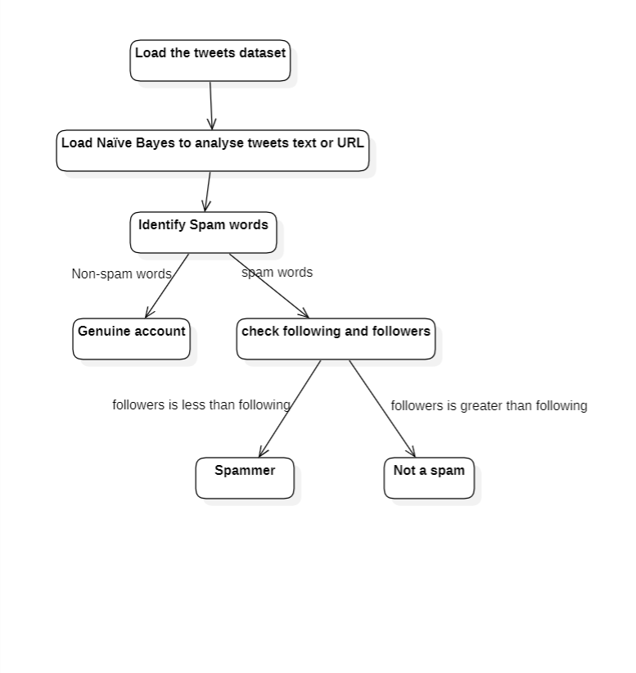
Module Design And Functionality

Slide 10
Libraries
NumPy
Tkinter
Pandas
Scikit–Learn (Also Known as sklearn)
Matplotlib

Slide 11
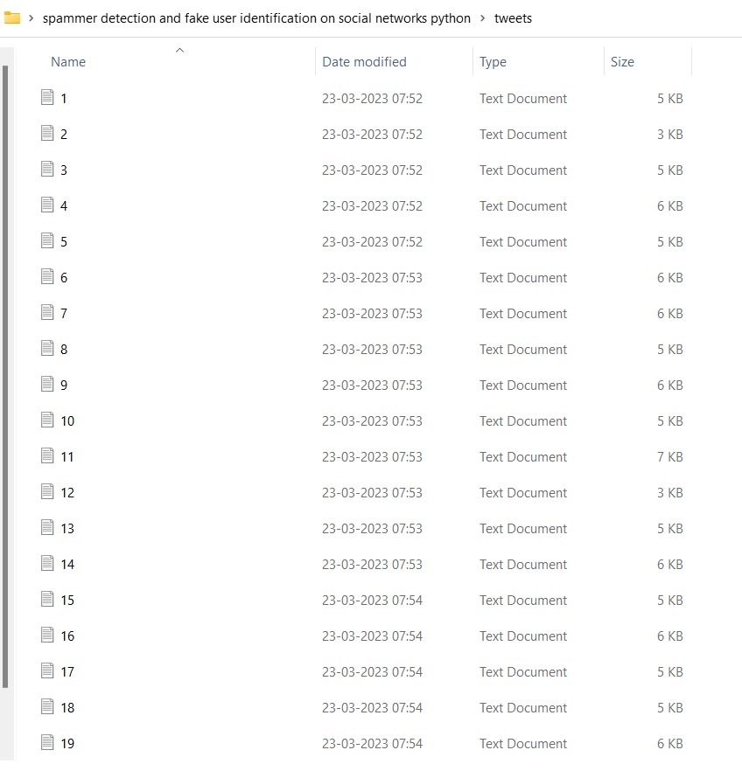
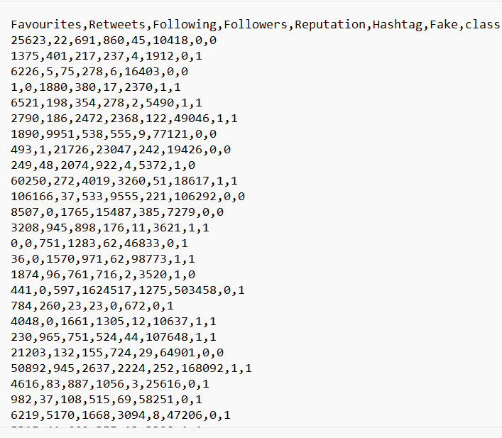
Dataset

Slide 12
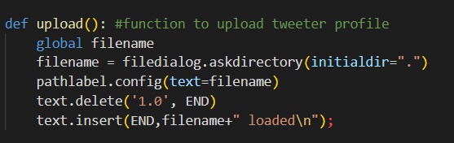
Input:
We extracted the data from dataset by using this upload function and we are showing the dataset as filename loaded.
output:
Here we are uploading the tweets dataset. So, it is showing that tweets loaded

Slide 13
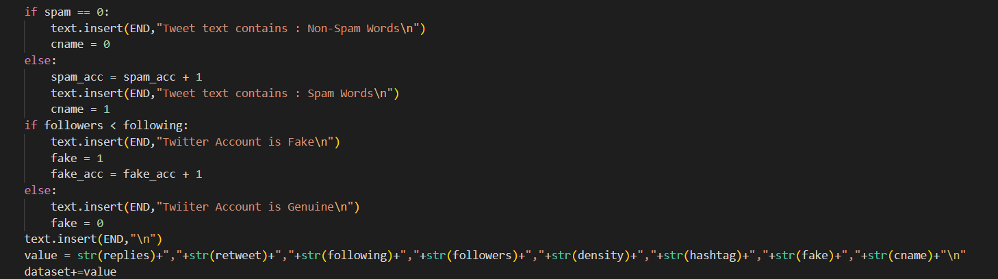
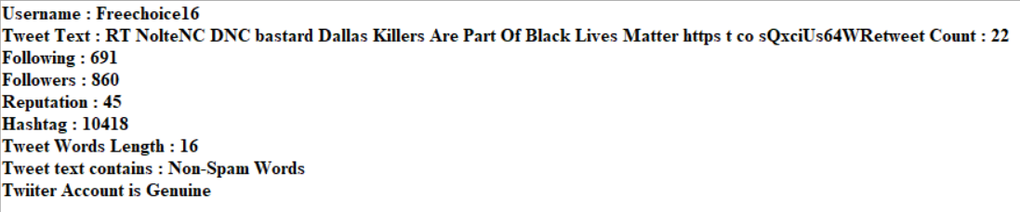
Input:
It takes the followers and following from the tweets dataset, by using that it shows weather the account is fake or genuine.
Output:

Slide 14
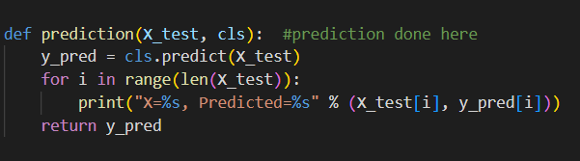
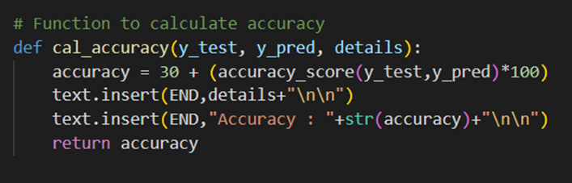
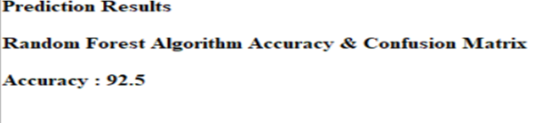
Input:
The training and testing of data is done using the following code , By using the predicted data we are calculating the Accuracy.
Output:
The predicted accuracy is shown below

Slide 15
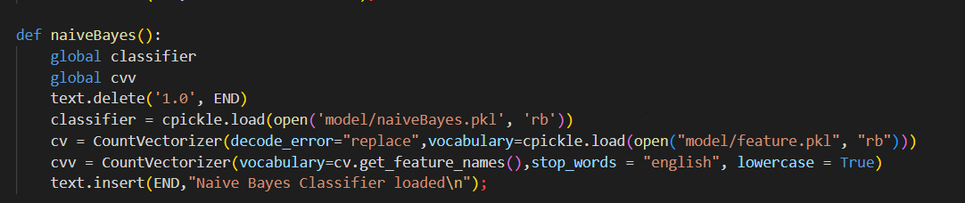

Naïve Bayes algorithm
Naïve Bayes algorithm
Naïve Bayes is better for classifying the user tweets with stemming techniques and stop words. And collect dataset from tweeter and it is used for classifying the user tweets into spammer or non-spammer.
Output:
It loads the algorithm and shows that the naïve bayes classifier is loaded

Slide 16
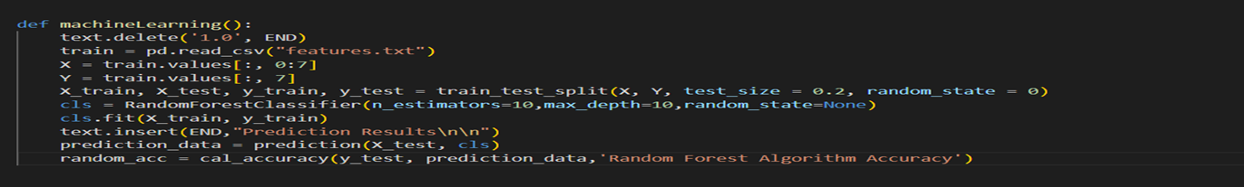
Random Forest Algorithm
Input
The training data and Testing data is Gathered from the training dataset. In each data which we are gathered we have to take the particular information and we have to preprocess the data. Finally we have to predict the data.

Slide 17
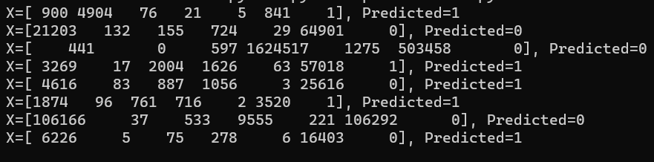
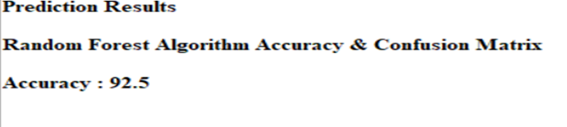
Output:
The predicted training and testing data of the random forest algorithm is shown below
The accuracy of the random forest algorithm is shown below

Slide 18
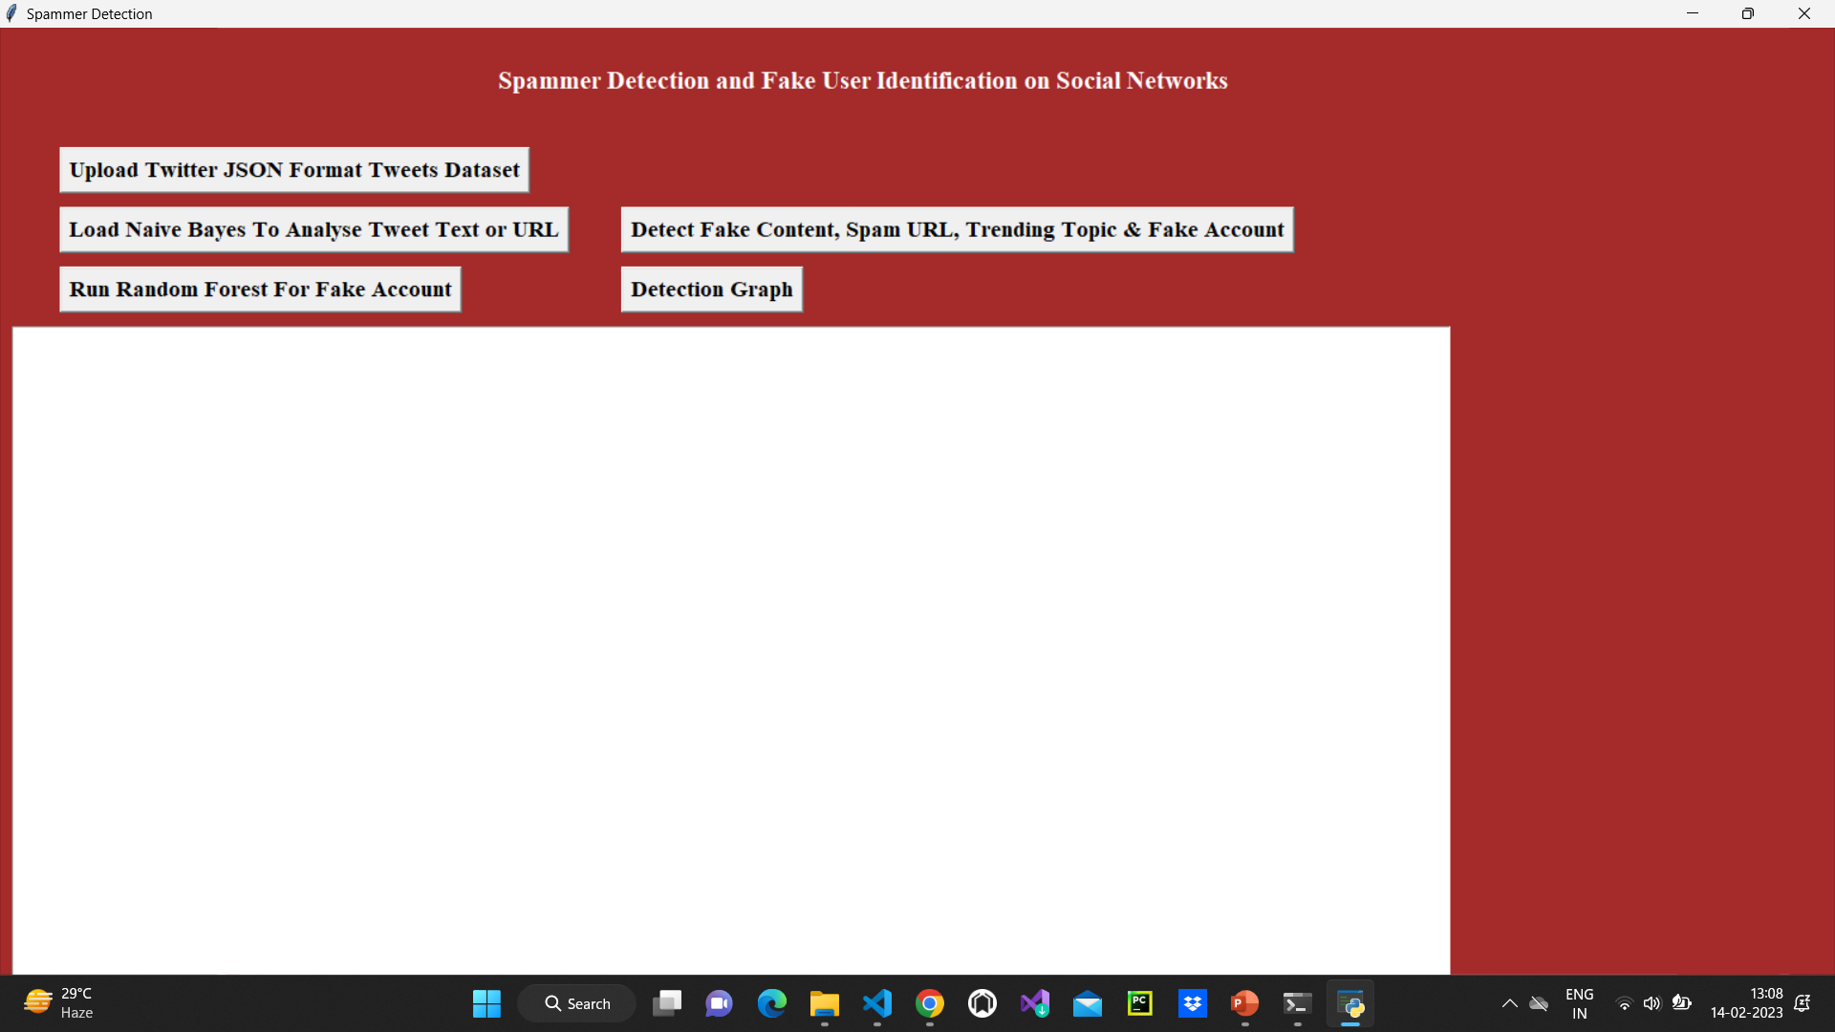
Result

Slide 19
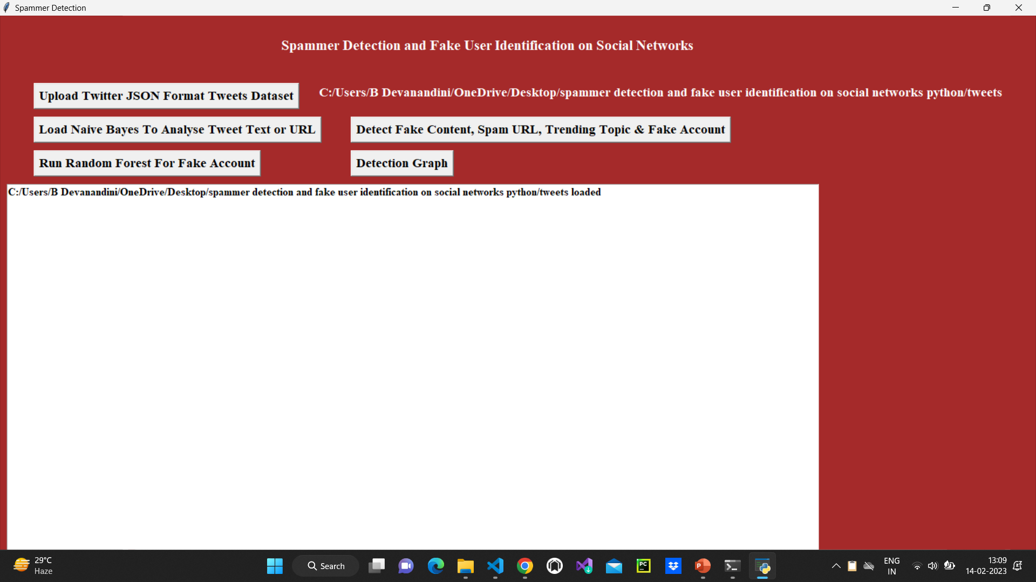
Result

Slide 20

Result

Slide 21
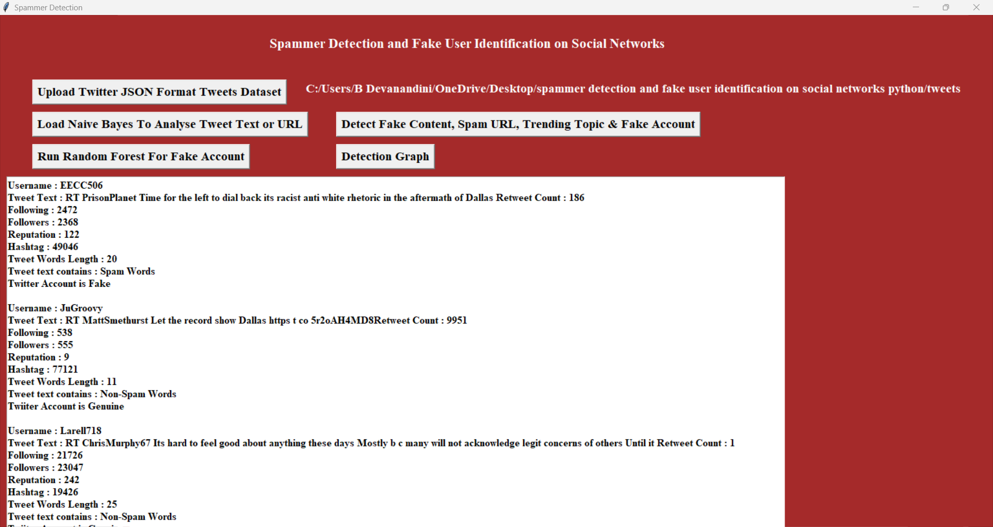
Result

Slide 22
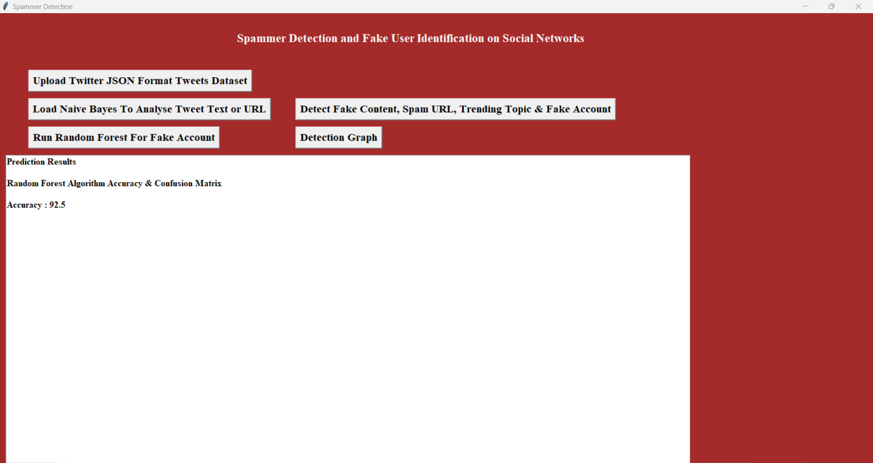
Result

Slide 23
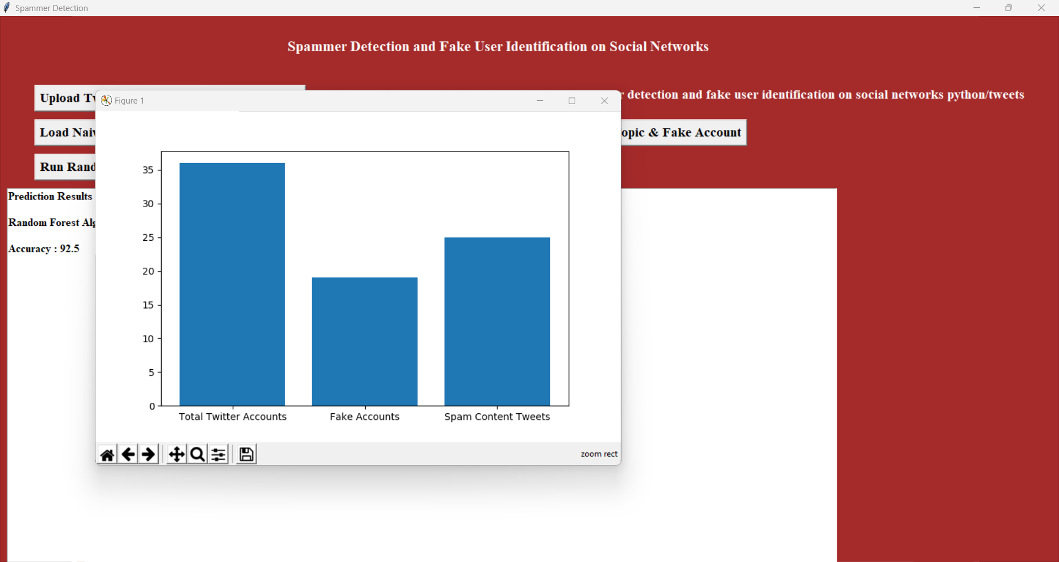
Result

Slide 24
References
B. Erçahin, Ö. Aktaş, D. Kilinç, and C. Akyol, ‘‘Twitter fake account detection,’’ in Proc. Int. Conf. Comput. Sci. Eng. (UBMK), Oct. 2017, pp. 388–392.
F.Benevenuto, G. Magno, T. Rodrigues, and V. Almeida, ‘‘Detecting spammersonTwitter,’’inProc.Collaboration,Electron.Messaging,AntiAbuse Spam Conf. (CEAS), vol. 6, Jul. 2010, p. 12.
S. Gharge, and M. Chavan, ‘‘An integrated approach for malicious tweets detection using NLP,’’ in Proc. Int. Conf. Inventive Commun. Comput. Technol. (ICICCT), Mar. 2017, pp. 435–438.
S. J. Soman, ‘‘A survey on behaviors exhibited by spammers in popular social media networks,’’ in Proc. Int. Conf. Circuit, Power Comput. Technol. (ICCPCT), Mar. 2016, pp. 1–6.

Slide 25
Conclusion
In this project, we performed a review of techniques used for detecting spammers on Twitter. False news identification on social media networks is an issue that needs to be explored because of the serious repercussions of such news at individual as well as collective level .
The dataset has been collected and preprocessed. The preprocessing is carried out by the python libraries. The examination model is obtained from the preprocessing. The distinguish matrix is designed by using the examination model.
The machine learning algorithm includes Random Forest, Naïve Bayes are utilized for the identification of fake users. The results are recorded and analyzed. The presented method is yielded 92% accuracy in detecting the fake users for the defined environment.

Slide 26
THANK YOU

